Slide 2
Structure
Structure 1:
Torch tensors
Regression (scikit-learn & pytorch)
Classification (scikit-learn & pytorch)
NN
Structure 2:
Dataset+scikit-learn
Torch tensors
Regression in PyTorch
Classification in PyTorch
NN

Slide 3
Basic Premise
Machine learning allows us to tackle problems by letting a solution be found organically, rather than engineering a specific algorithm
We don’t give explicit instructions
We feed a model lots of data and let the model work out a solution
Machine learning is like farming
We are now in a position where ML capabilities exceed human ones in a wide variety of tasks

Slide 4
AI vs ML vs DL

Slide 5
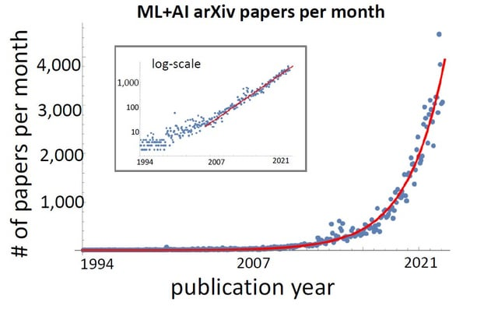
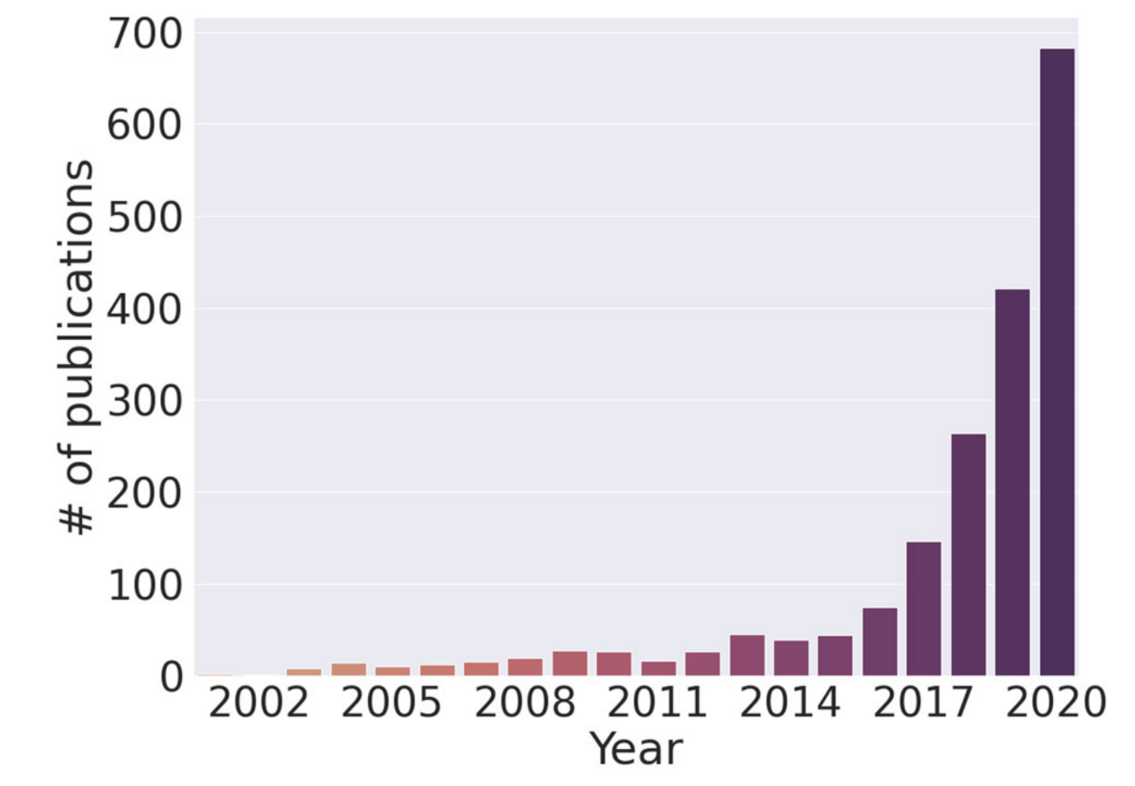
Why ML now?

Slide 6

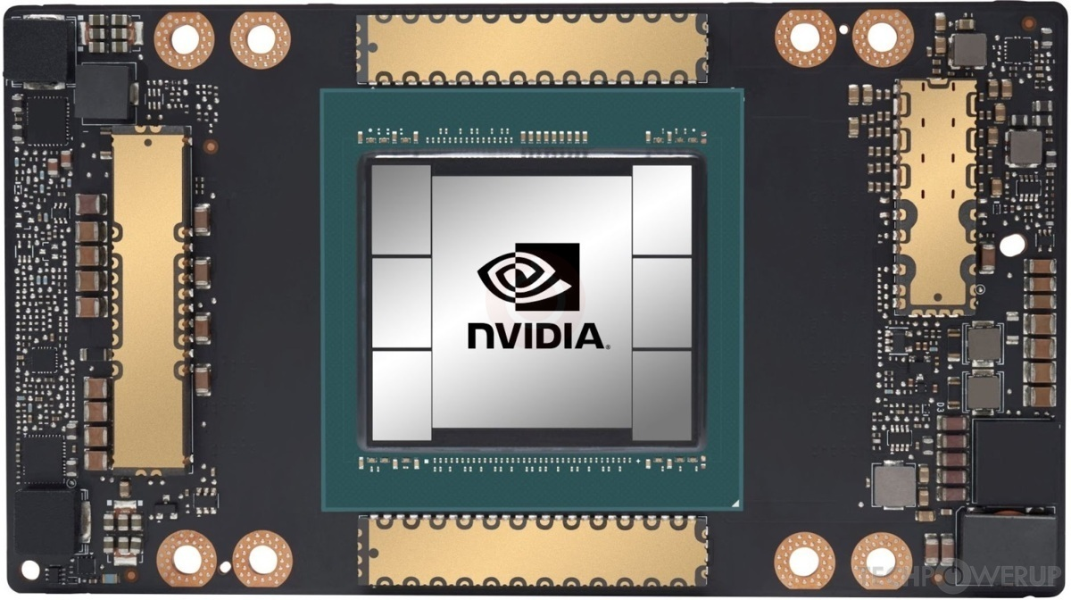
Why ML now?
Access to large datasets
Increased computational power
Breakthroughs in algorithms
Open-source libraries
Companies doing AI
Economic and political motivation

Slide 7
AI Timeline in 21st Century
ImageNet, 2009 – Fei-Fei Li creates dataset
AlexNet, 2012 – Alex Krizhevsk’s model for images uses deep learning (CNN)
Tensorflow, 2015 – Made open-source
AlphaGo, 2016 – Beats Lee Sidol 4-1
Transformer, 2017 – “Attention is all you need”
AlphaFold2, 2020 – Wins CASP competition
ChatGPT, 2022 – Commercial LLM

Slide 8
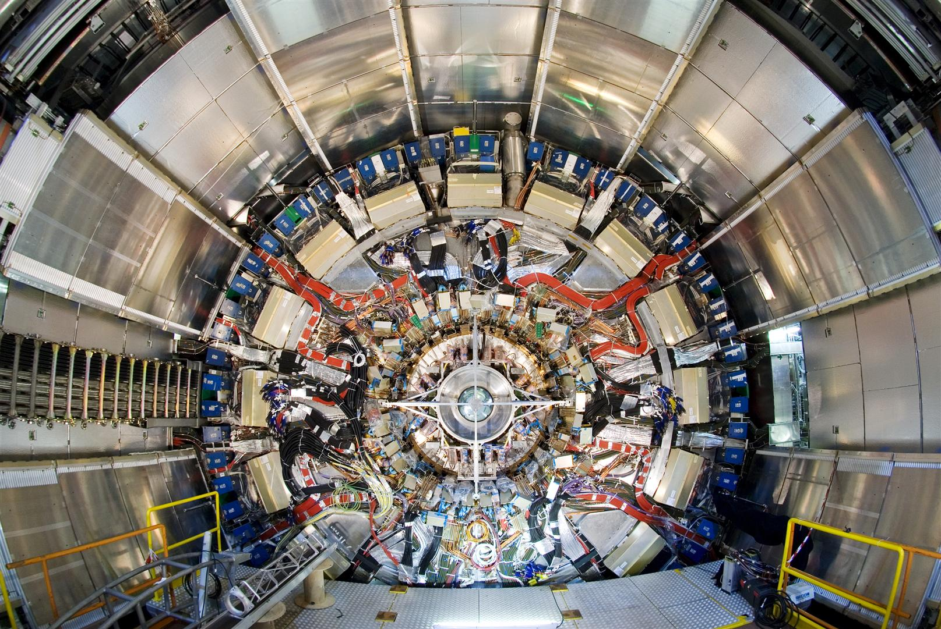
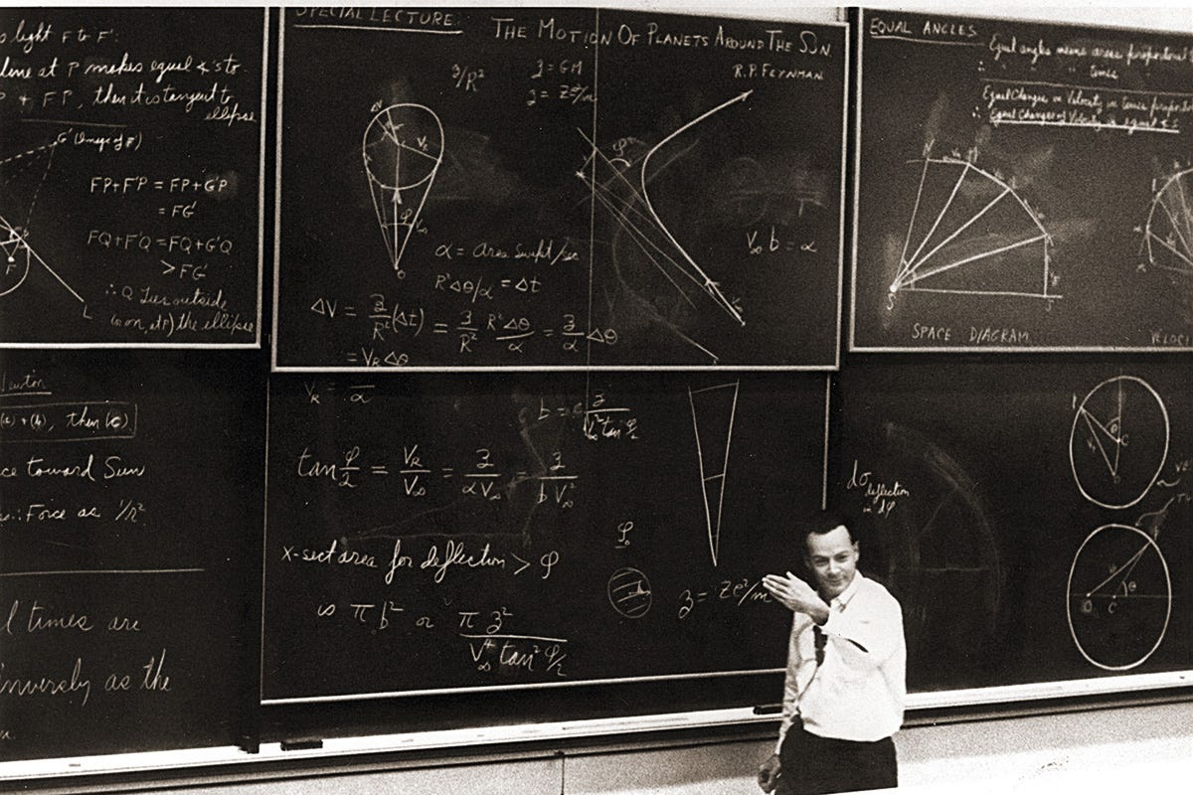
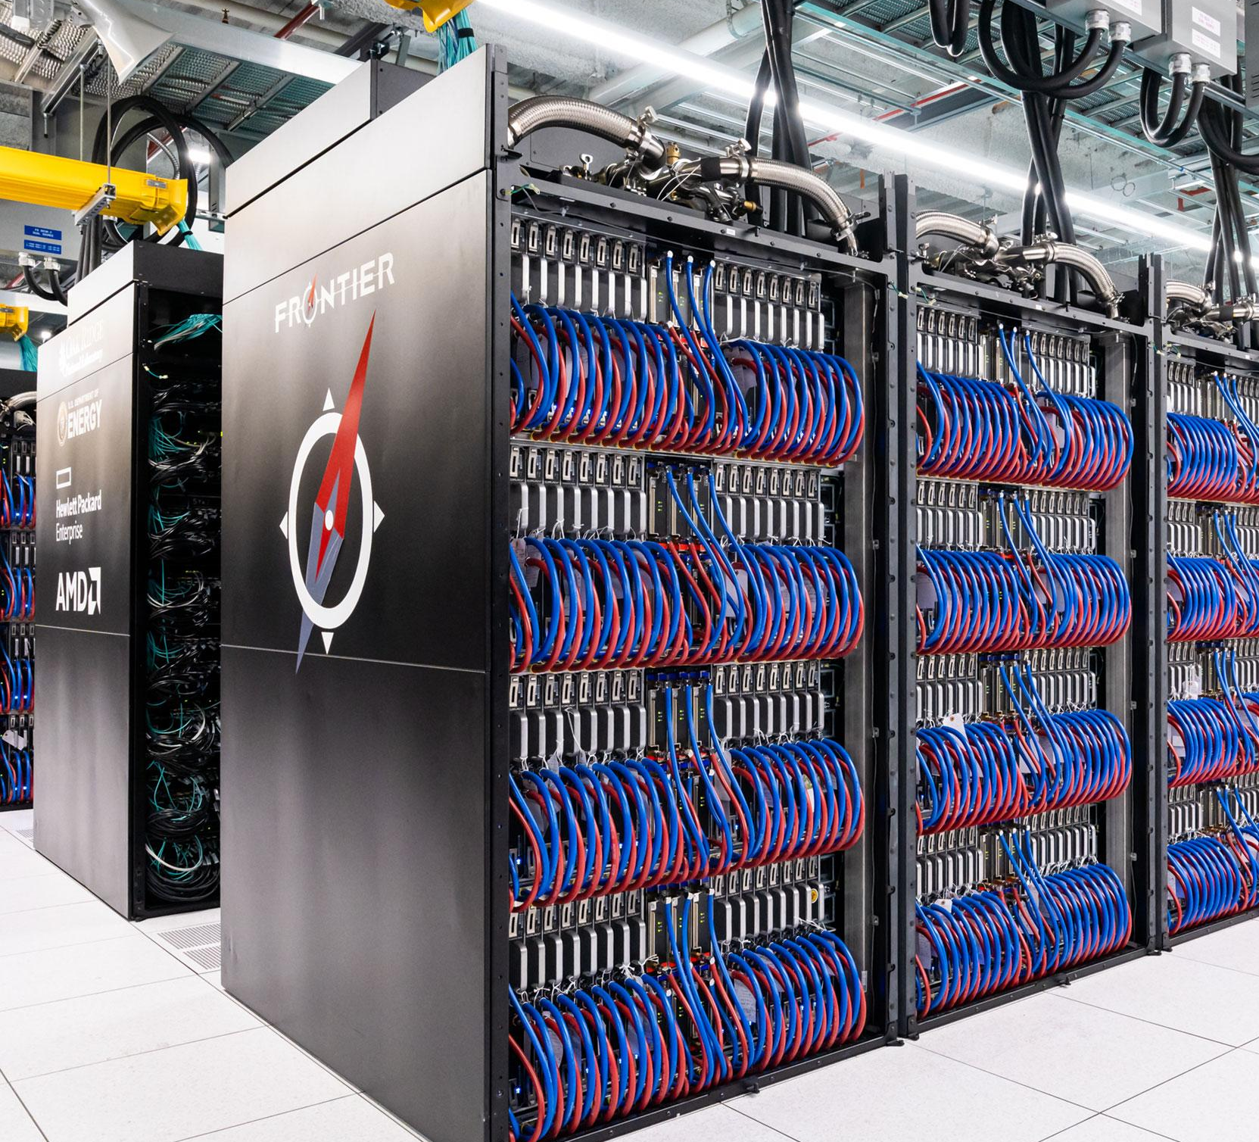
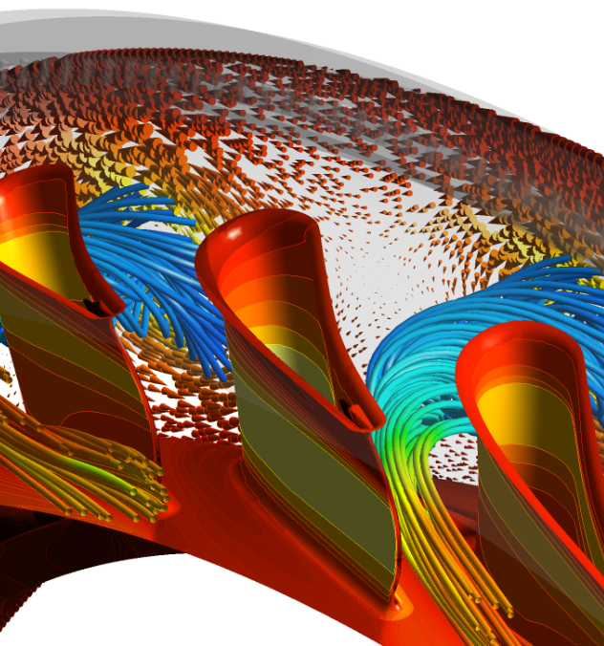
Machine Learning
❤️
Physical Science
Big experimental data
Data obeys laws
Know how to simulate
Historical symbioses with computing

Slide 9
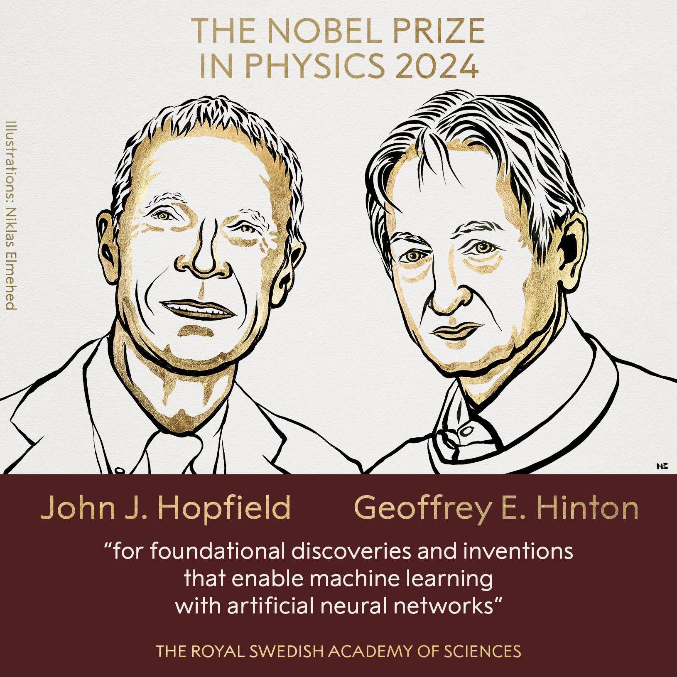
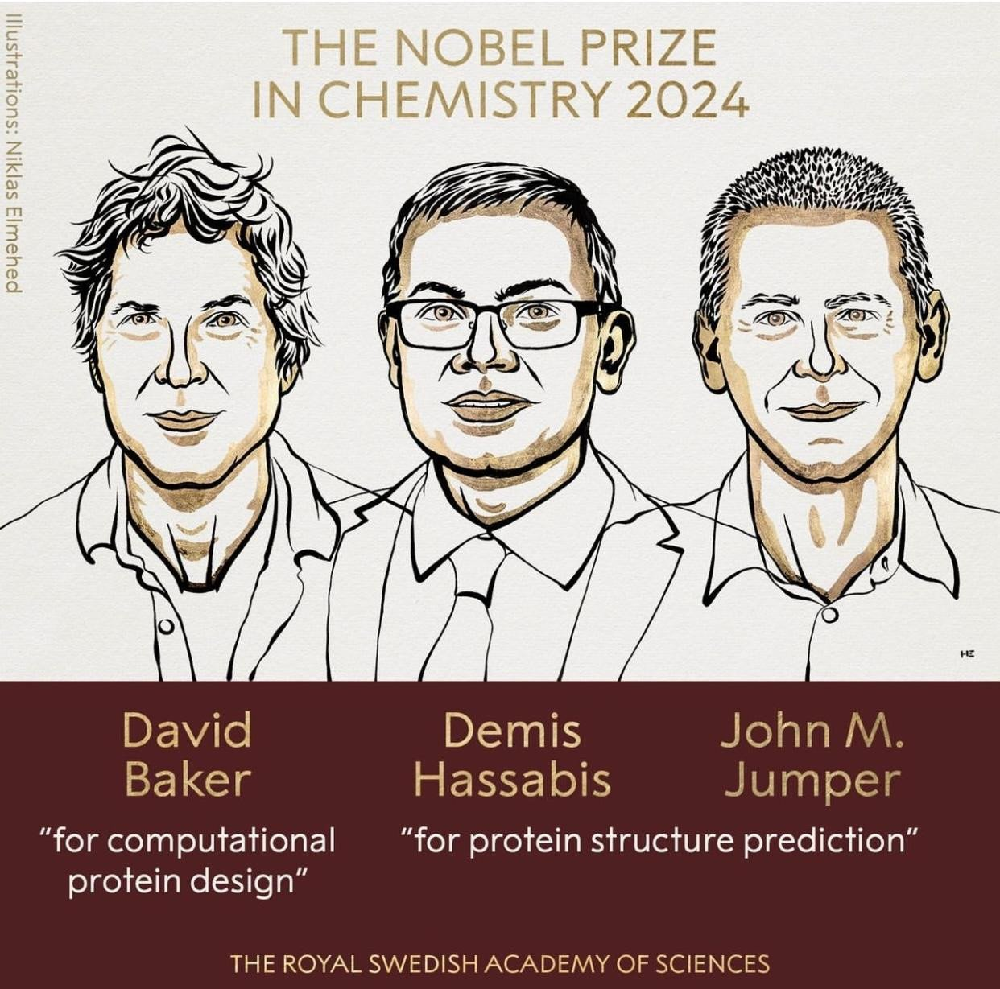

Slide 10
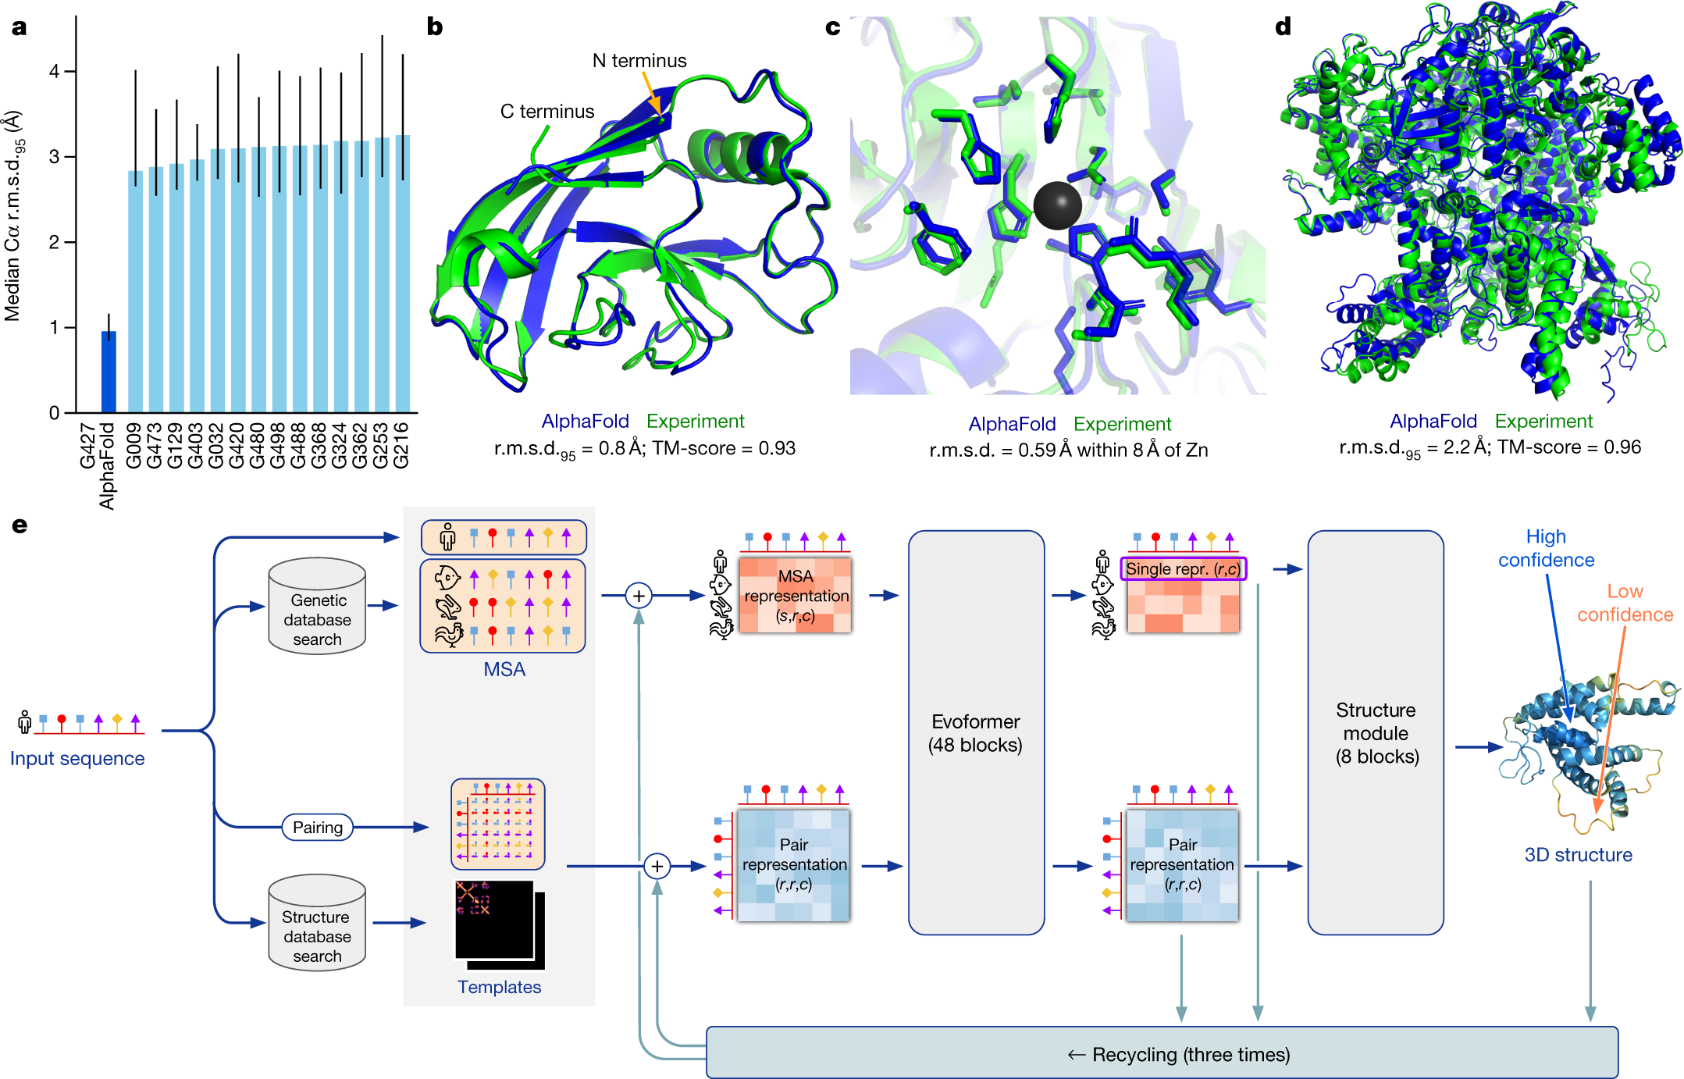
AlphaFold

Slide 11
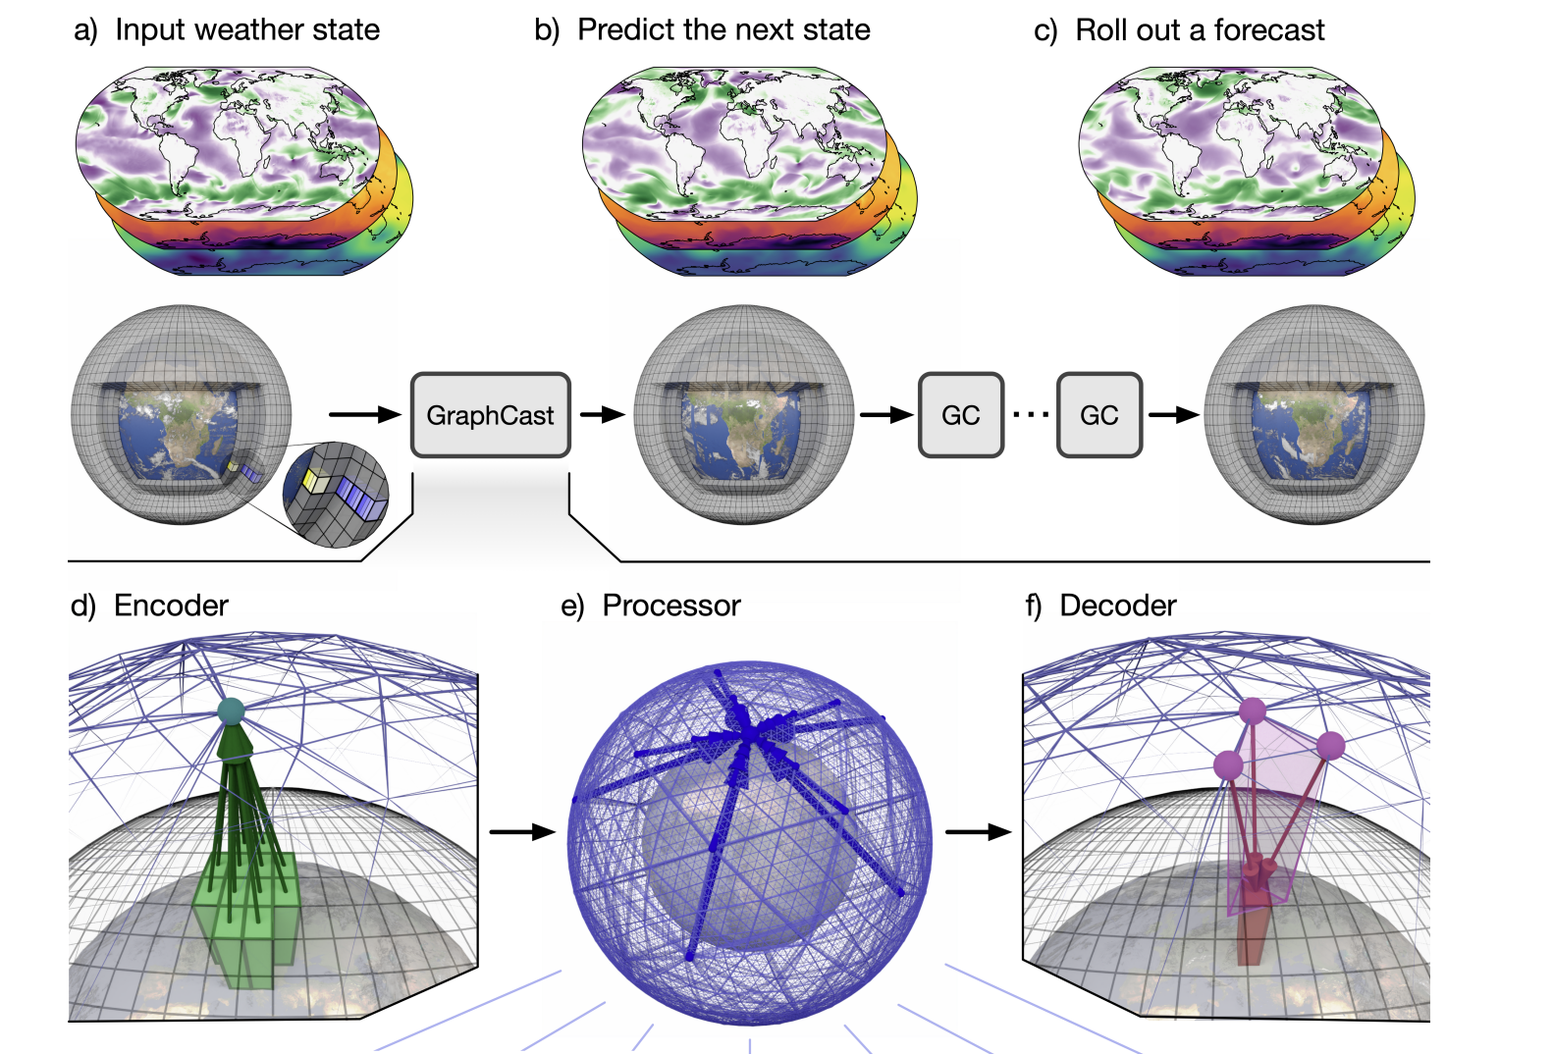
GraphCast

Slide 12
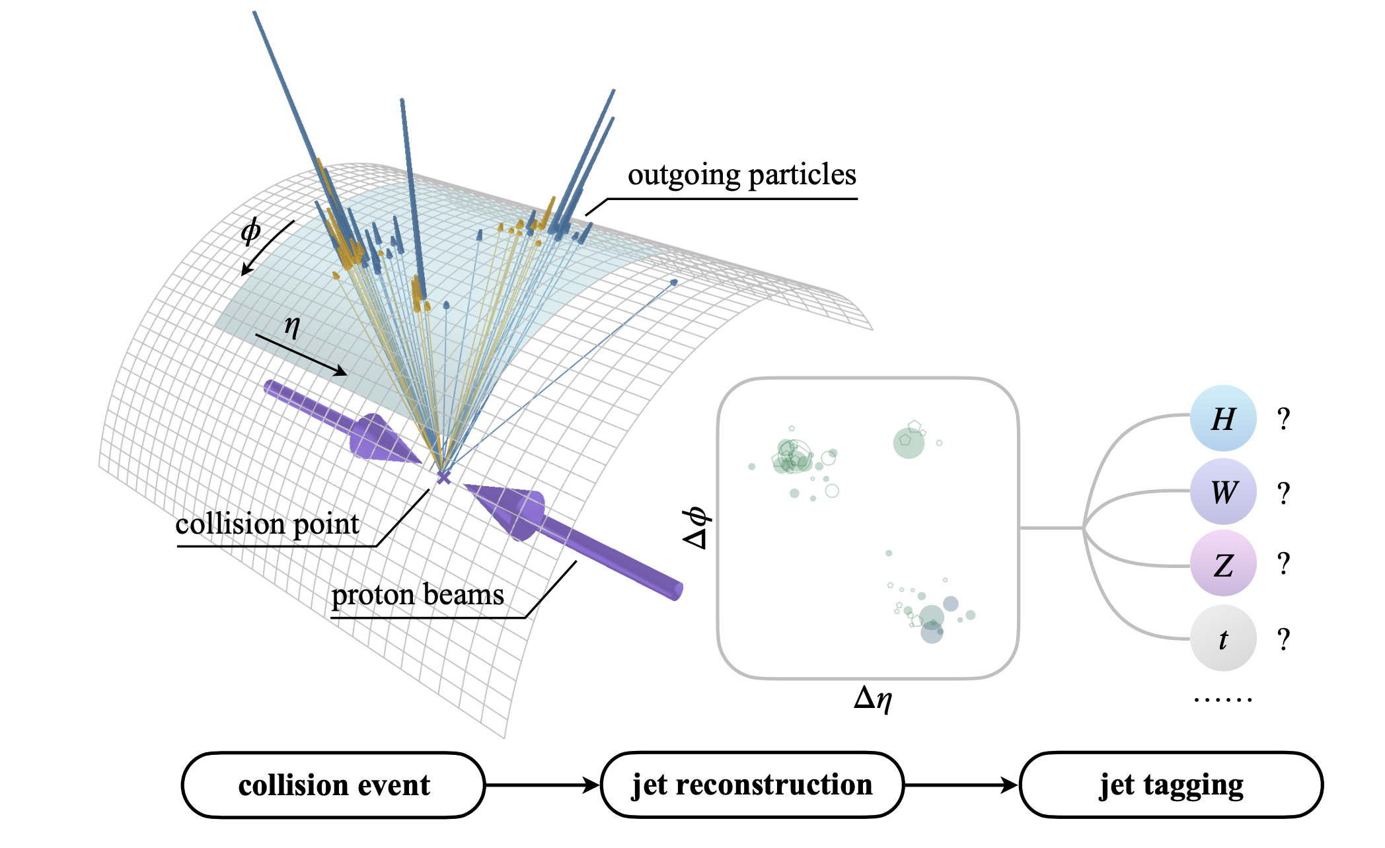
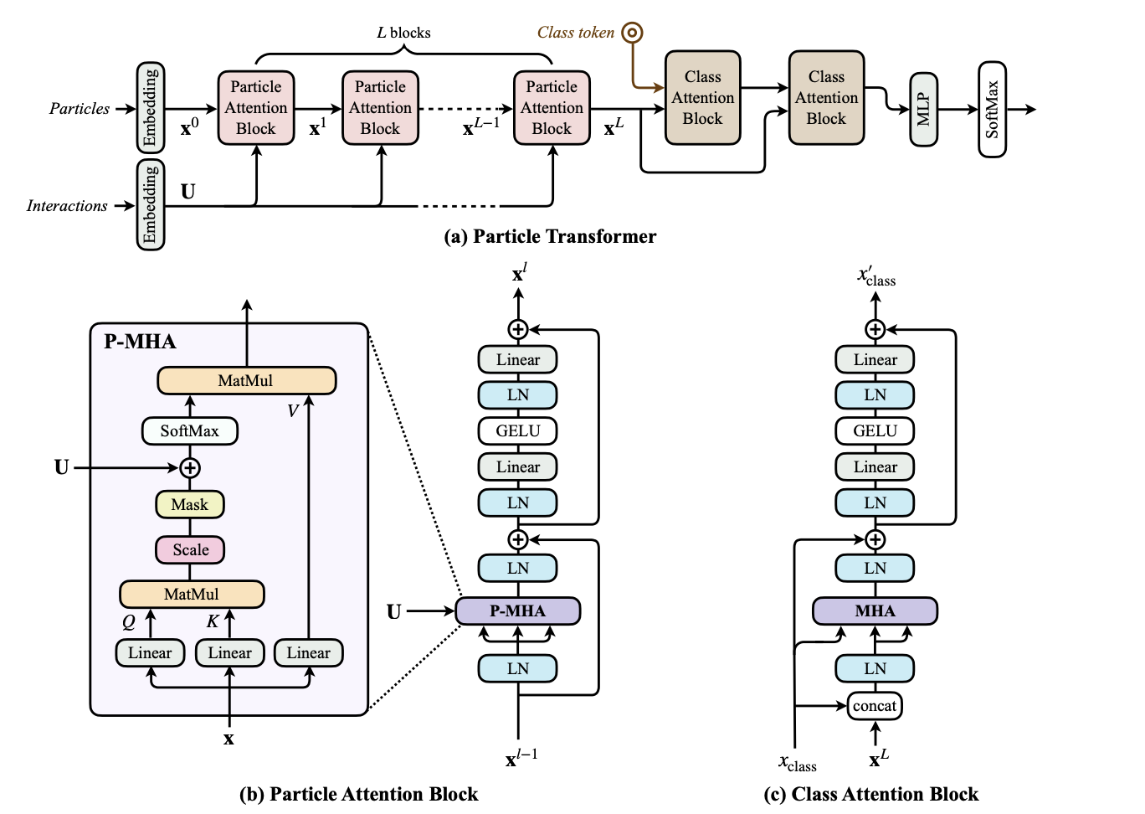
Particle Transformer

Slide 13

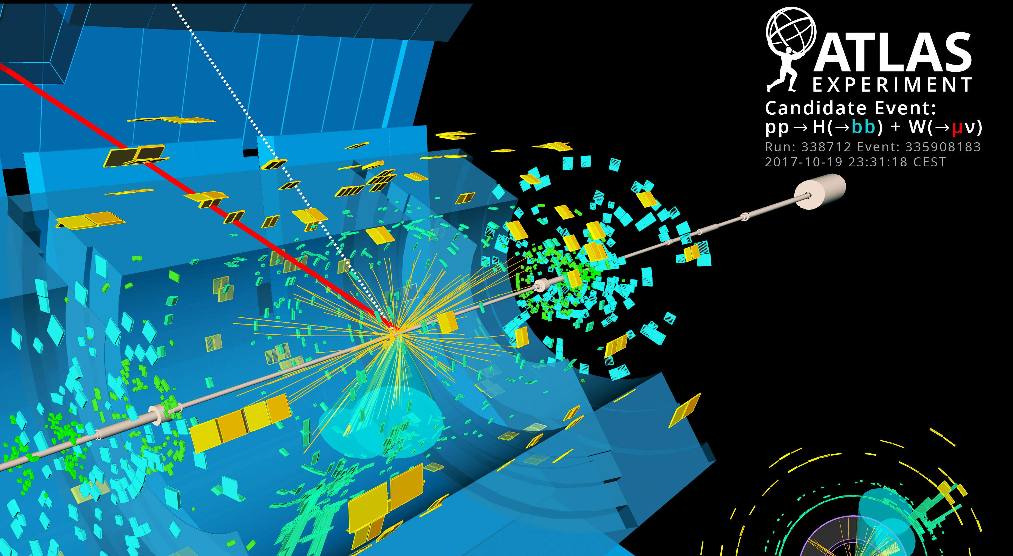
Physical Science Data
Large
Complex
High-dimensional
Highly structured
Physical laws provide constraints and correlations

Slide 14
Physical Science Data
Complex
Large
High-dimensioanl
Structured
Correlated

Slide 15
Physical Science Data
Large
Complex
High-dimensional
Highly structured
Physical laws provide constraints and correlations

Slide 16
What do we need to handle this?
Efficient numerical computation software
Optimised computing architecture
Easy-to-use ML frameworks?

Slide 17
GPUs

Slide 18
ML Python Frameworks
Sklearn – simple to use for simple, not so deep problems
Tensorflow – from Google, initially static computation graph, less clear syntax. Keras wrapper for building simple NNs
PyTorch – from Facebook, dynamic computation graph, now more common in research.
Jax – from Google, less oriented towards NNs
We will primarly use PyTorch

Slide 19

Python Frameworks

Slide 20
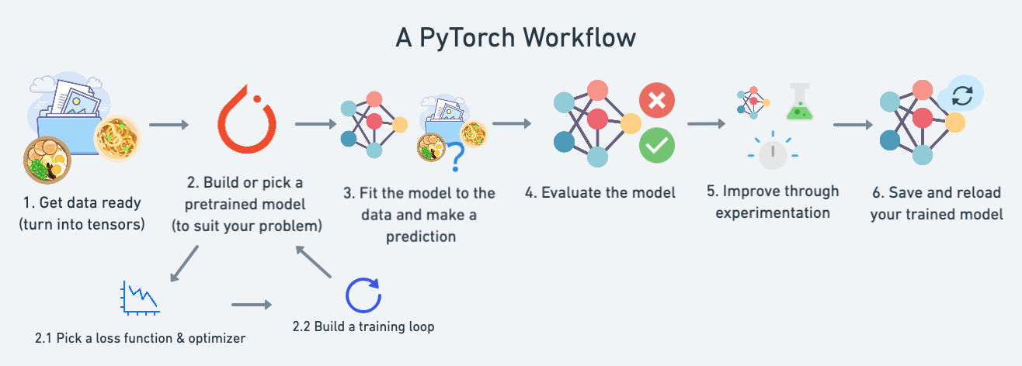
Tensors compatible with GPUs
Autograd for automatic differentiation
Dynamic computation graph

Slide 21
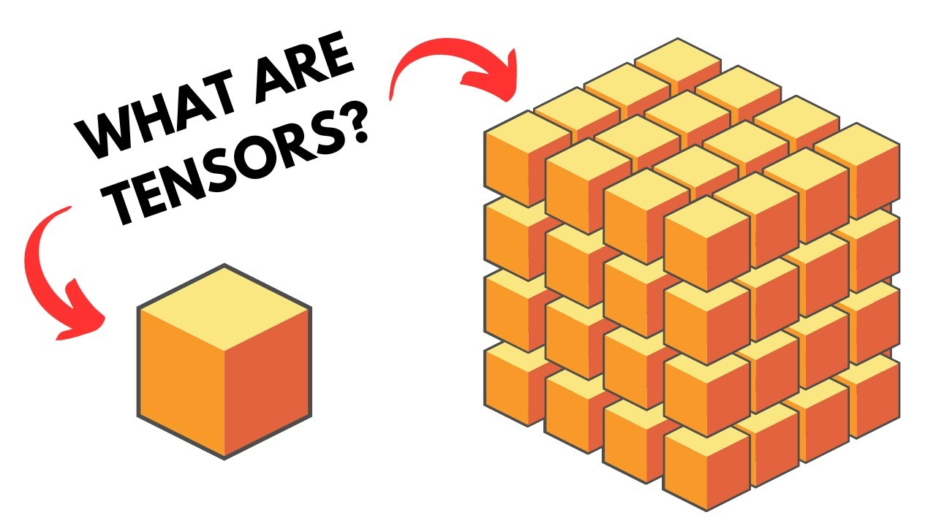
Tensors
Just think “arrays” which can be processed on GPUs…
Parallelised operations – no for loops here

Slide 22
Practical Activity #1
Designed to introduce PyTorch and working with tensors
This should take 20 minutes

Slide 23

Colab Tutorial Tips
By default all sub-sections are collapsed. You expand them thus

Slide 24
Data Requirements
Many examples
Correlated features
Quality
Diversity
Balance

Slide 25
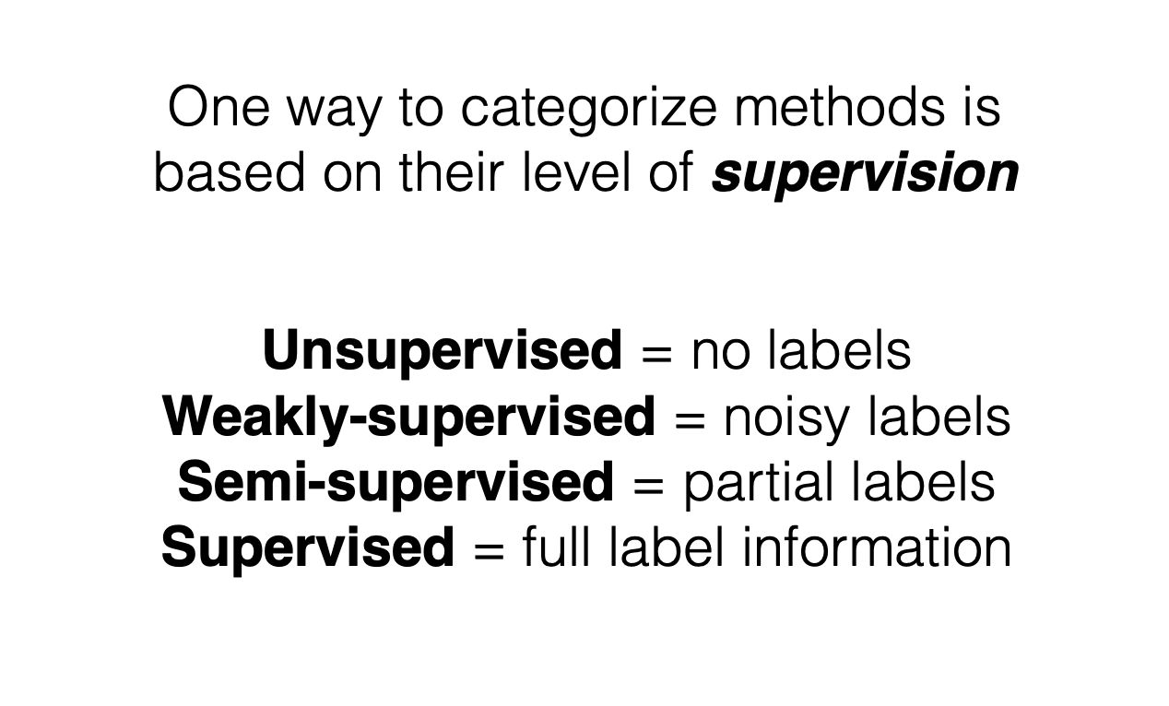
Types of Learning Tasks

Slide 26
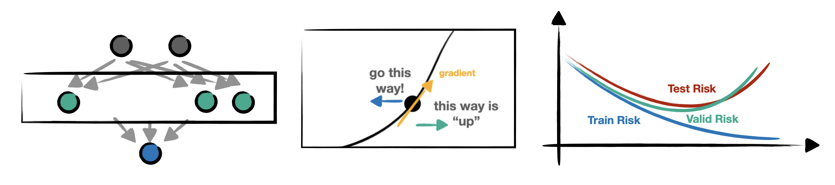
Supervised Learning

Slide 27
Notes from SLAC 2
Underlying, latent concept
We see some realization of this concept e.g. an image of a cat composed of pixels – the underlying concept is a cat
Type of latent information defines the task

Slide 28
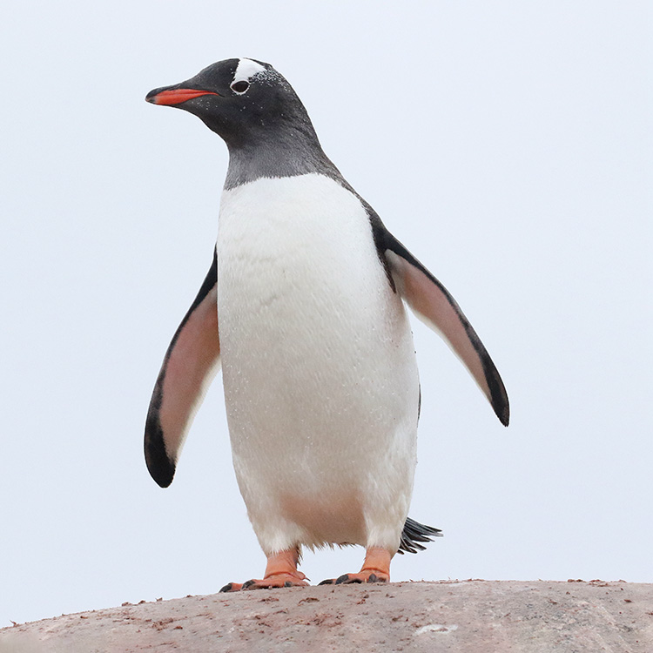
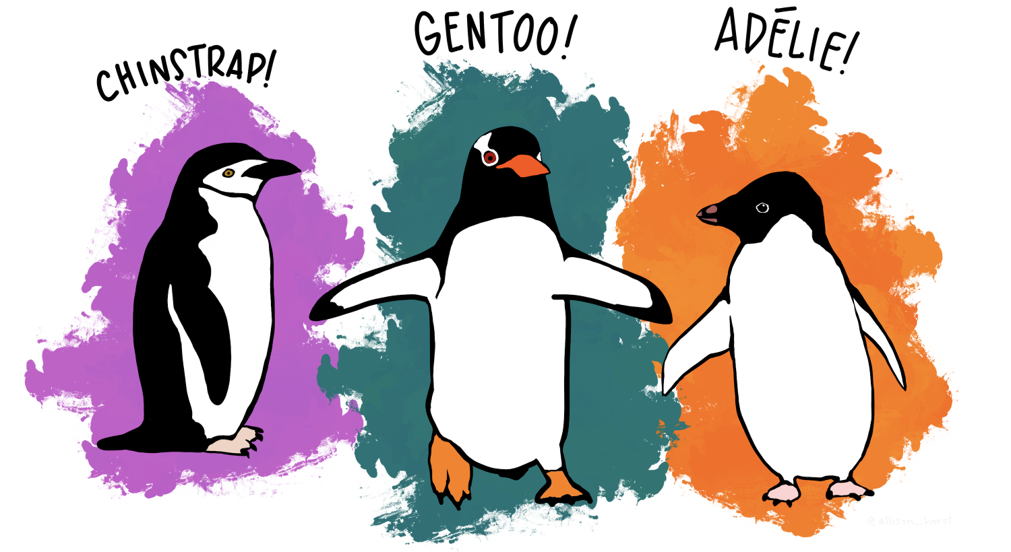
Example dataset

Slide 29
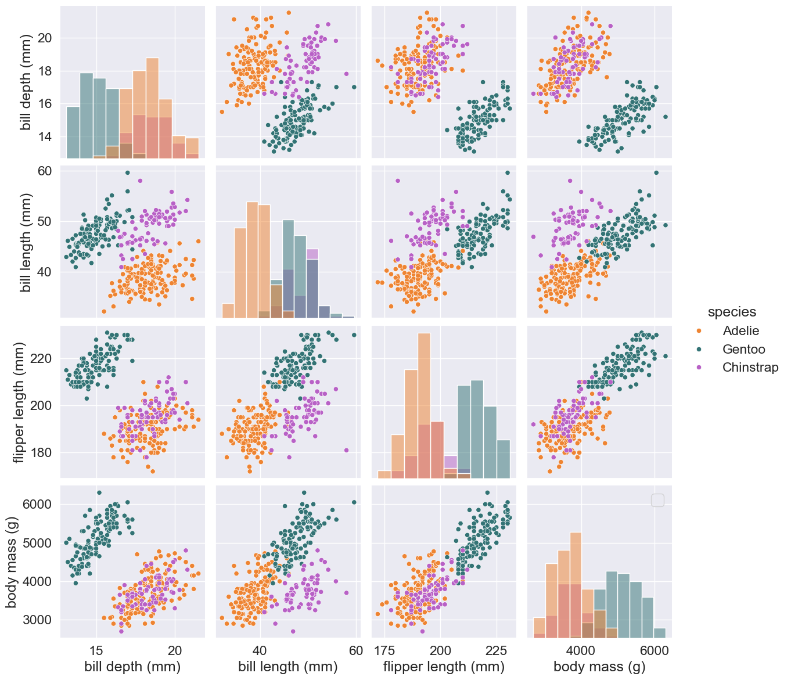

Slide 30
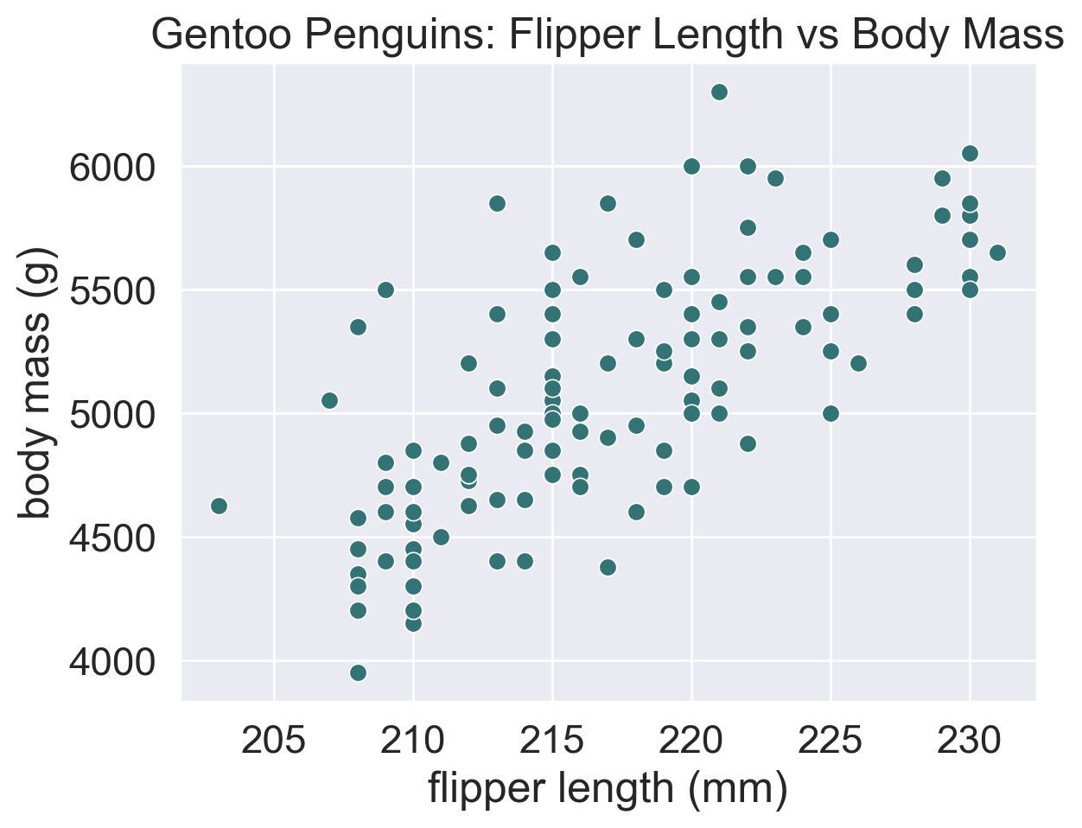

Slide 31
Regression
Predicting numerical data
How heavy is a penguin with this length of flipper?
The outputs are continuous

Slide 32
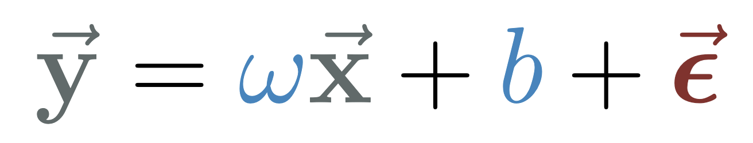
Linear Regression
A simple type of regression we will use
Vector of target data
Vector of input data
Vector of errors
Parameters to find (learn)

Slide 33
Linear Regression
A simple type of regression we will use
Vector of target data
Vector of input data
Vector of errors
Parameters to find (learn)

Slide 34
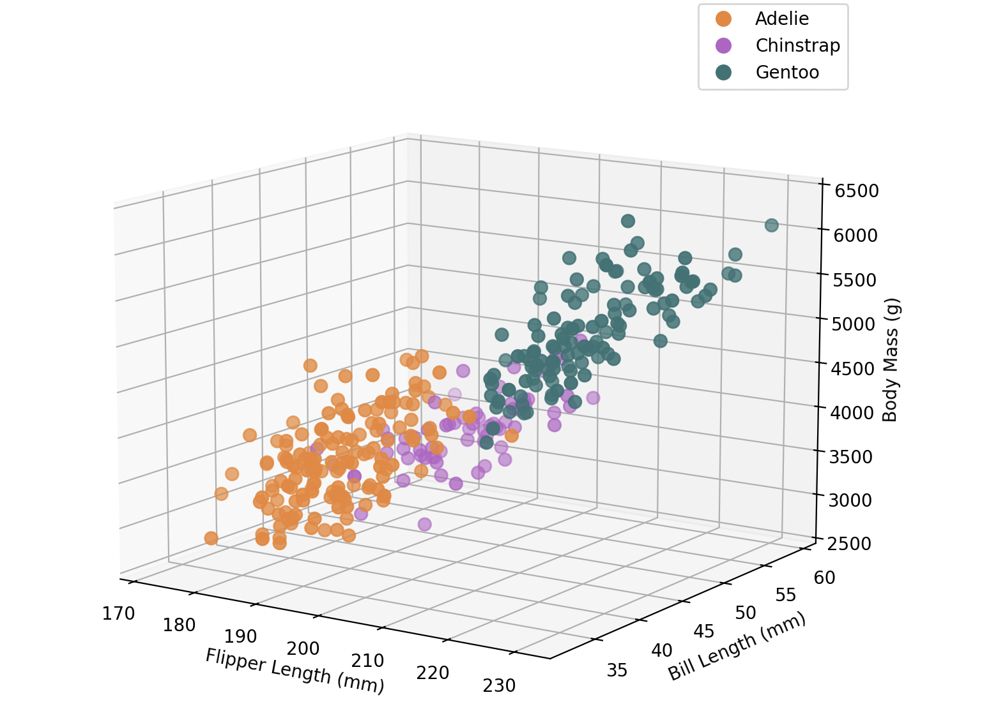
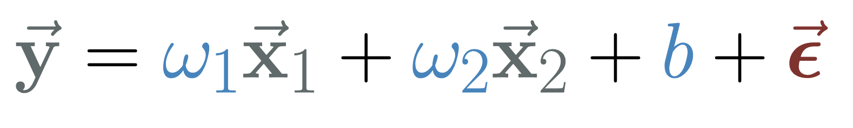
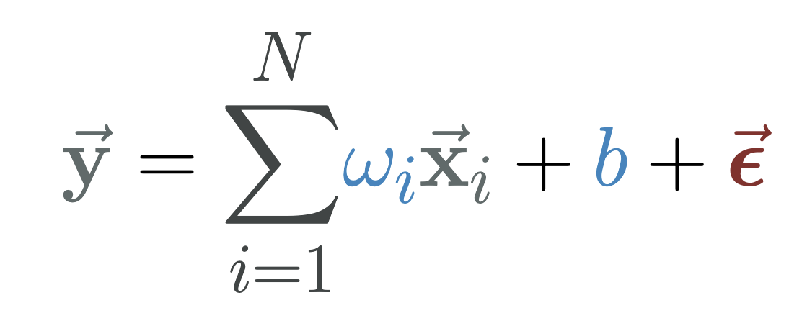
Multiple Linear Regression
Multiple inputs regress a single output
For N inputs:

Slide 35
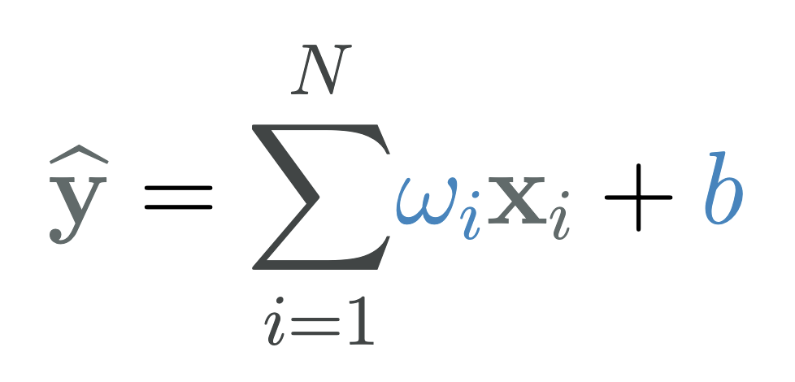
Linear Regression Analytic Solution
Optional slide

Slide 36
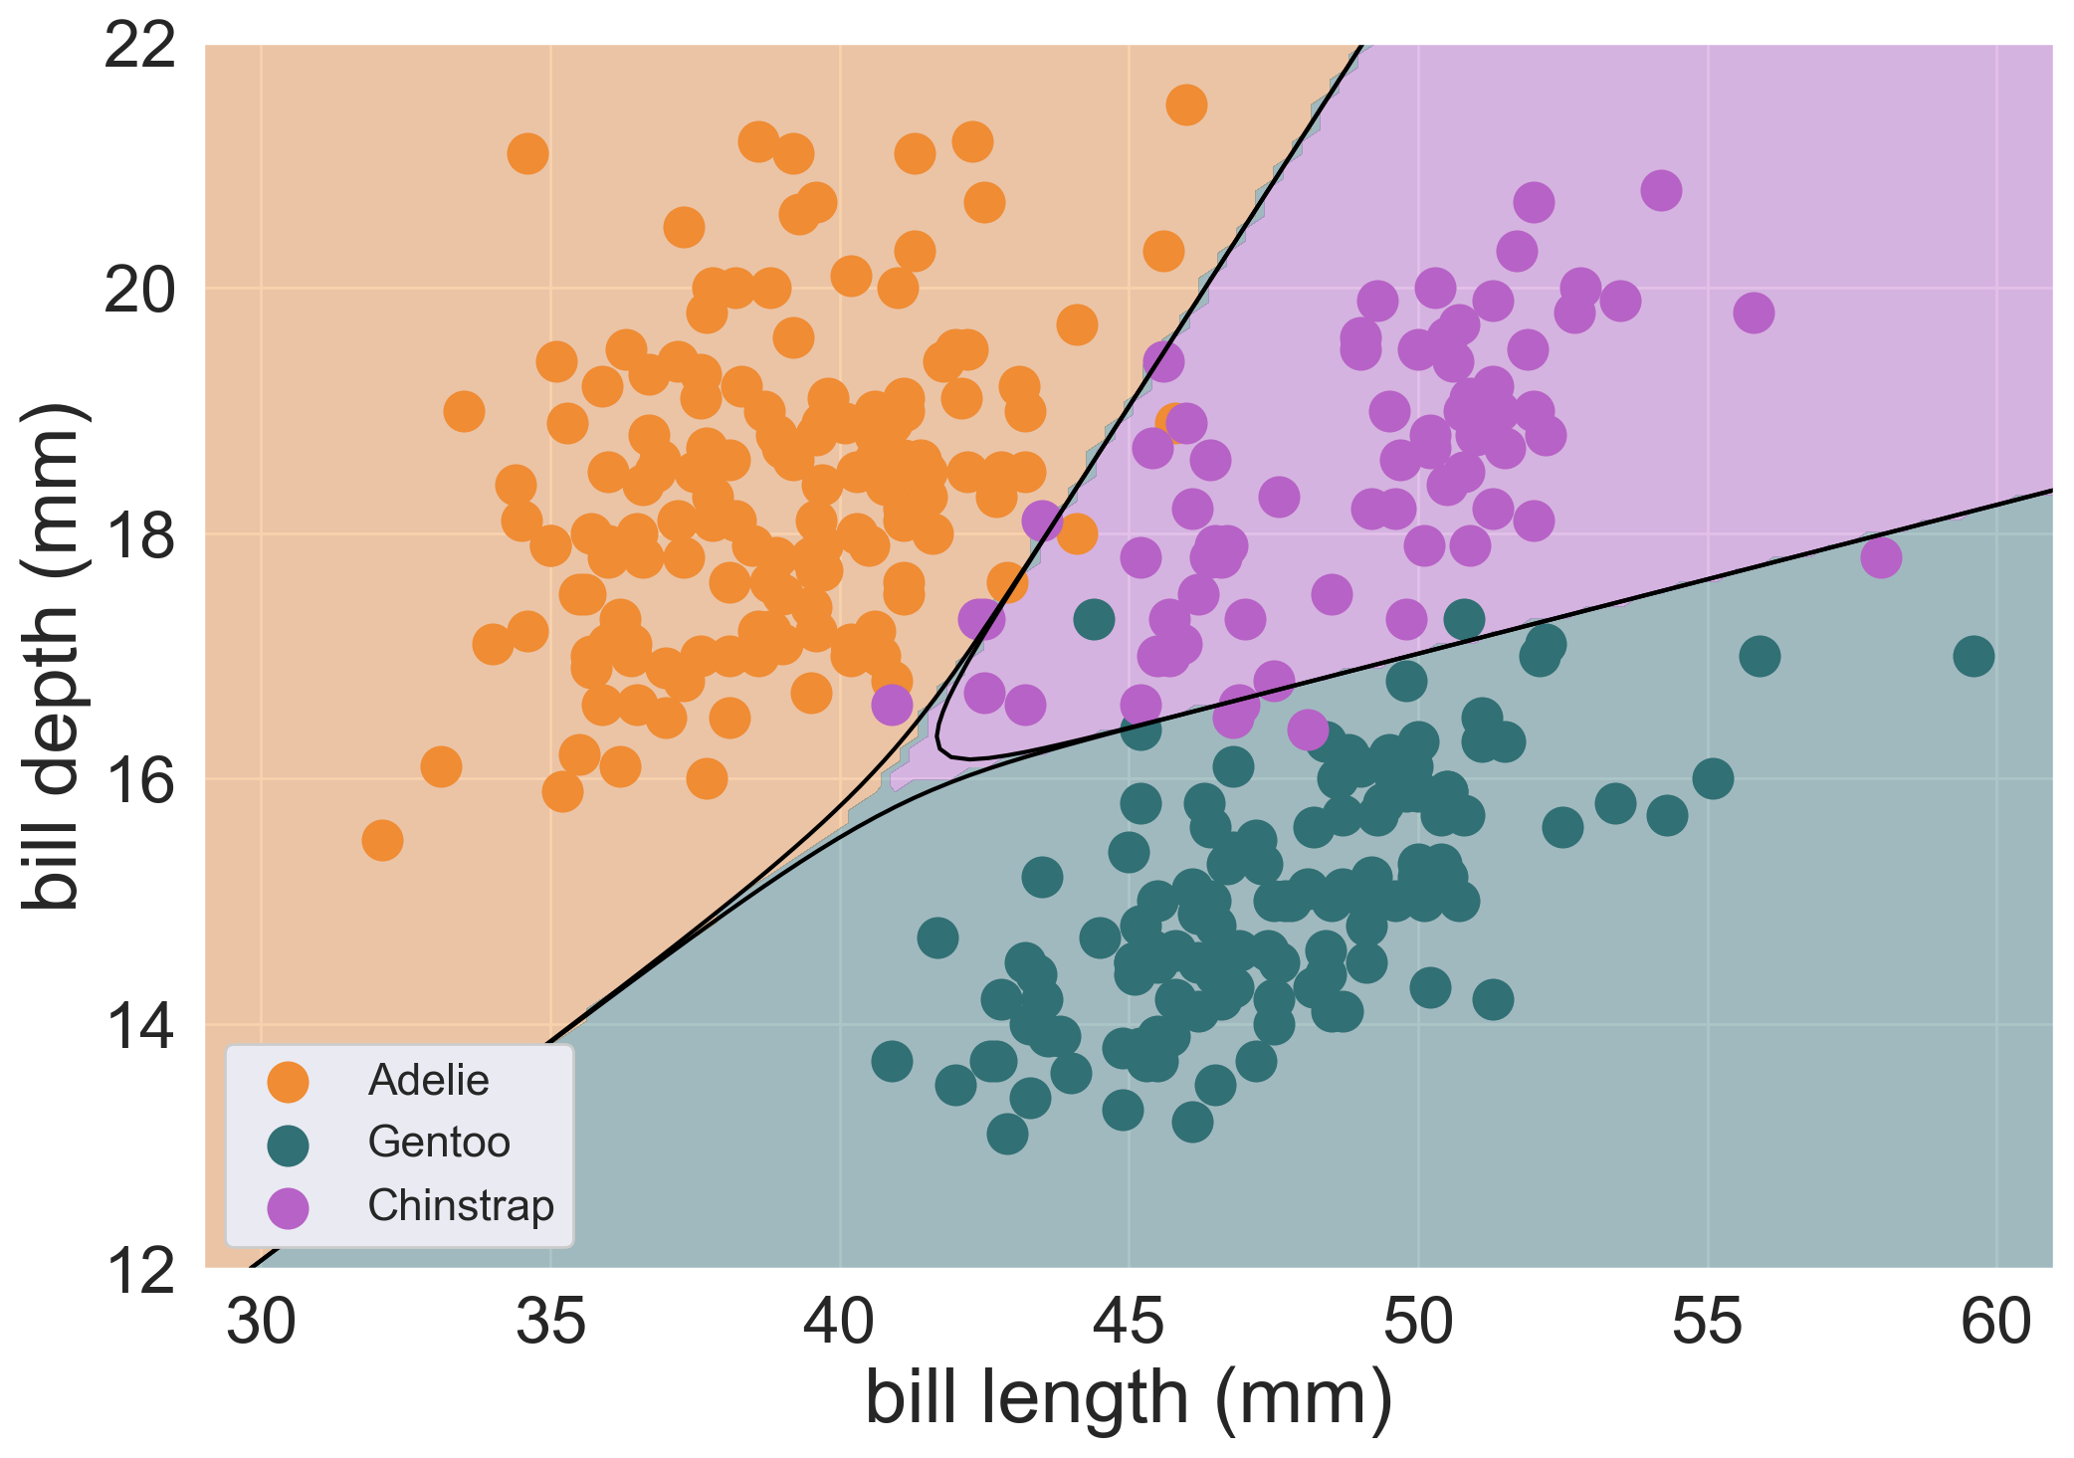
Classification
Predicting categorical data
Given these features, what species of penguin is this?

Slide 37
Classification
Predicting categorical data
Given these features, what species of penguin is this?

Slide 38
Task 2
Using scikit-learn to
Predict the

Slide 39
Things to think about
How to evaluate the model

Slide 40
Practical #2: Scikit-Learn for ML
Load the data and visualize it
Normalise the data
Perform simple linear regression using Scikit-learn
Perform multiple linear regression using Scikit-learn
Visualise the results
Perform ternary classification use Scikit-learn
Visualise the results

Slide 41
Comments
How do we visualize?

Slide 42
Summary
Scikit-learn solves these problems analytically, but we will now solve them using PyTorch in a machine learning way
This will serve as a pre-cursor to DNNs

Slide 43
Basic Supervised Learning Structure
Make a prediction with a model
Check how good the prediction is
Update the model intelligently
A computational model: takes data, outputs prediction
Objective function: compare prediction to truth
Training strategy: how to change model parameters to improve performance?

Slide 44
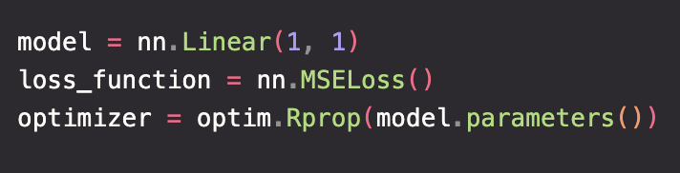
ML Structure
Model makes prediction
Compare prediction to target
Update the model intelligently

Slide 45
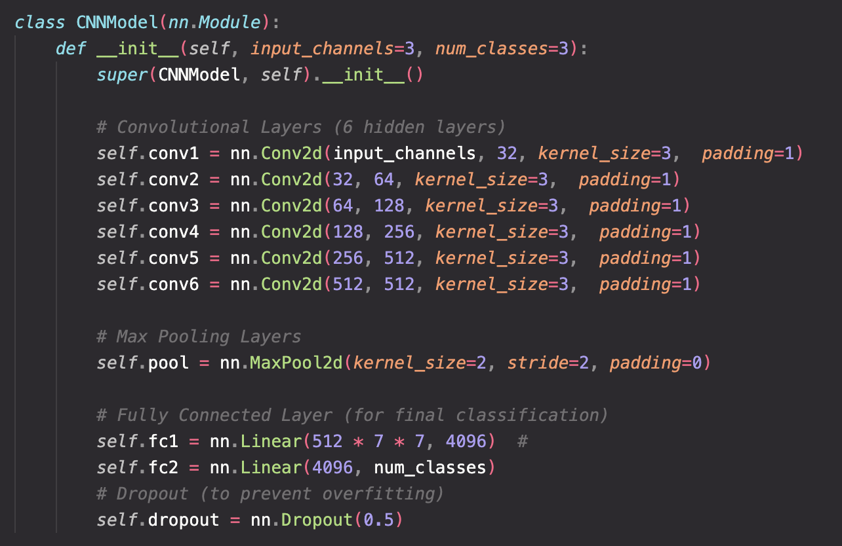
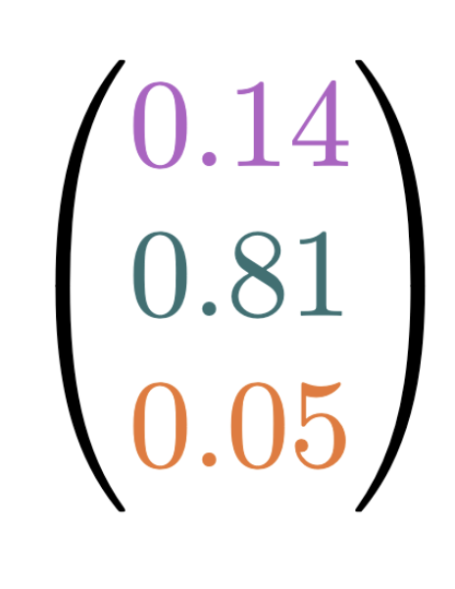
Model
Maps inputs to outputs
A specific architecture performs a specific set of mathematical operations

Slide 46
Linear Models
The prediction depends linearly on the parameters
In ML contexts, the parameters are learnable: refined over learning epochs
All the linear models in Scikit-learn: https://scikit-learn.org/stable/modules/linear_model.html#linear-models
https://en.wikipedia.org/wiki/Linear_predictor_function

Slide 47





Linear Models
x1
x2
$$\text{Σ}$$
+b
y
x3
x4

Slide 48

Objective Function
Objective function / loss function / cost function / error function
How good is my model? Compare prediction to truth
Model 1
Model 2

Slide 49
Inputs
Model 1
Model 2
Target
Outputs
Prediction 1
Prediction 2

Slide 50
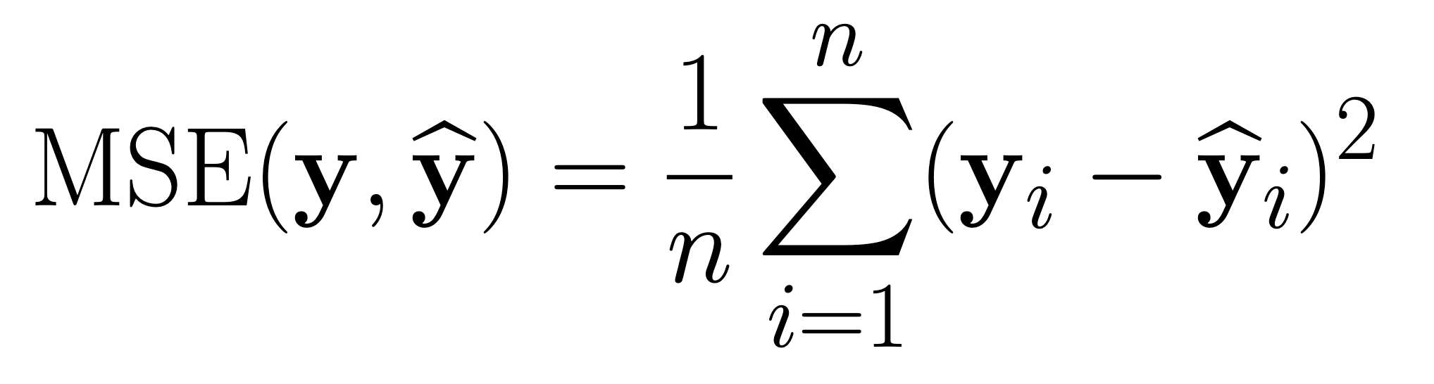
Objective Function
How close is my model’s prediction to the target?
Outputs
Model 1 prediction
Target
Model 2 prediction
Function quantifies “closeness” of prediction and target
Average squared difference between target and predicted data points

Slide 51
Objective Function
How close is my model’s prediction to the target?
Outputs
Model 1 prediction
Target
Model 2 prediction
Function quantifies “closeness” of prediction and target
Average squared difference between target and predicted data points

Slide 52

Optimisers
The optimisation of an objective function is a very general problem across much of applied mathematics (so not exclusive to ML) e.g. travelling salesman problem.
Improve the model based on its current and past performance.
Involve searching the model parameter space for a better set of parameters. Many ways to achieve

Slide 53
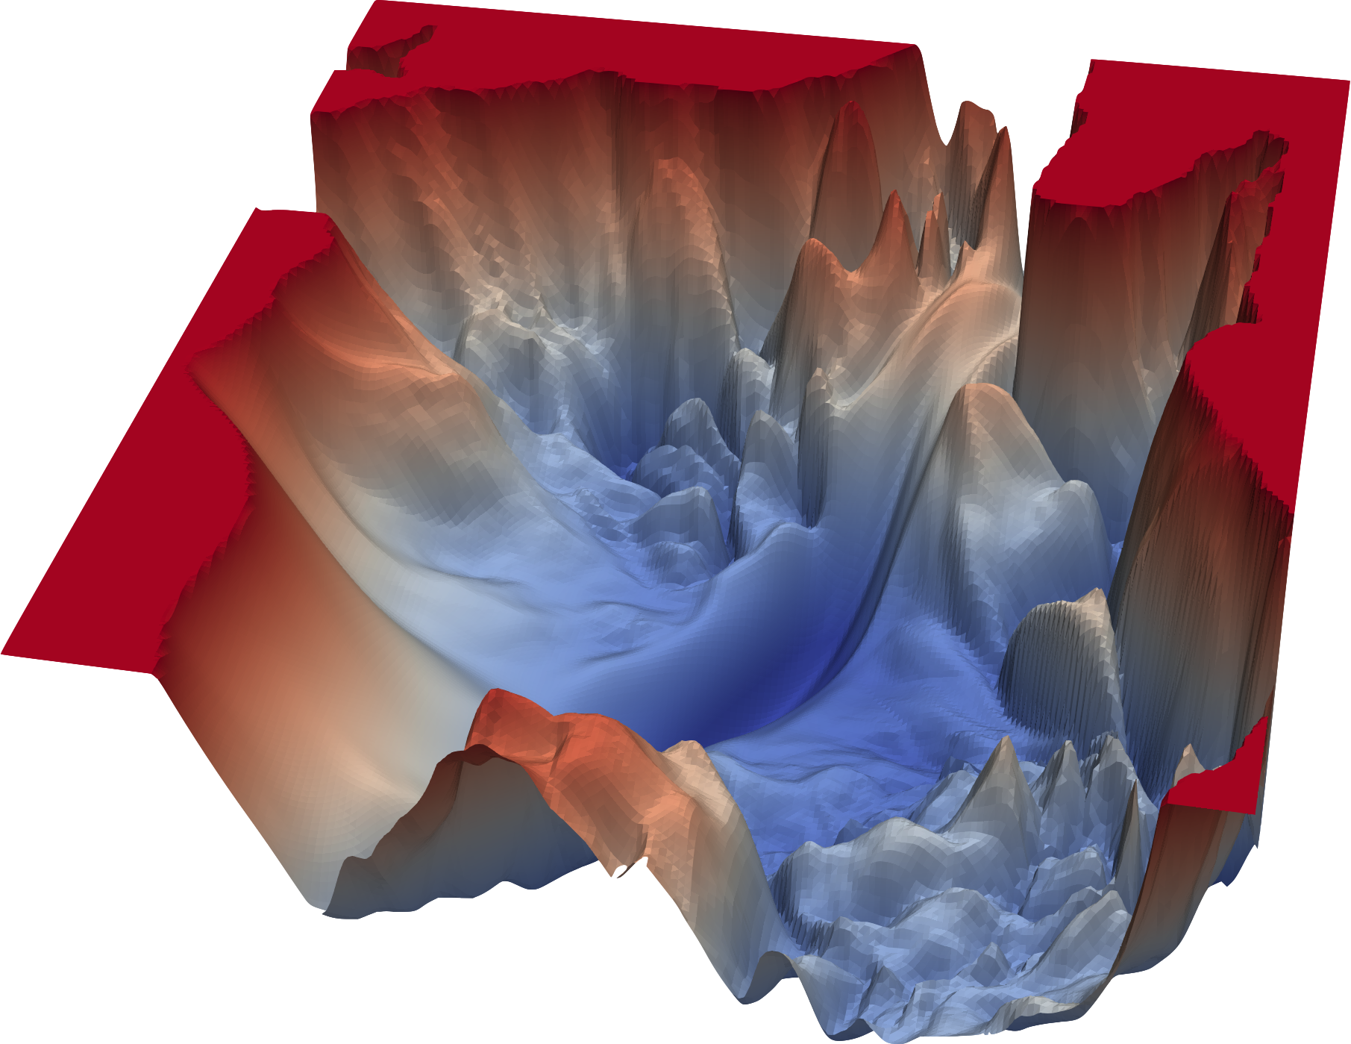
Gradient Descent
For iteratively finding a minima…
Compute the gradient where you are
Move in the direction of steepest descent
Challenges:
Computing the gradient when there’s many parameters
Knowing how big a step to take
Knowing you’re at the global minima
Other optimisers exist but just used gradient descent…

Slide 54
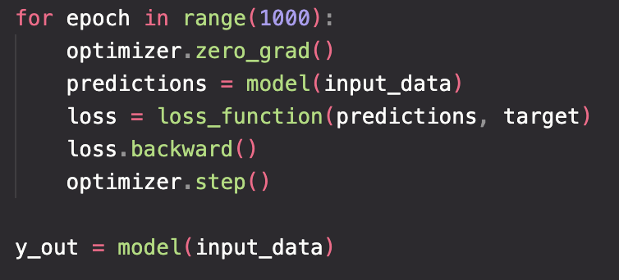
Linear Regression Example
Definitions
Training loop

Slide 55
Sigmoid

Slide 56
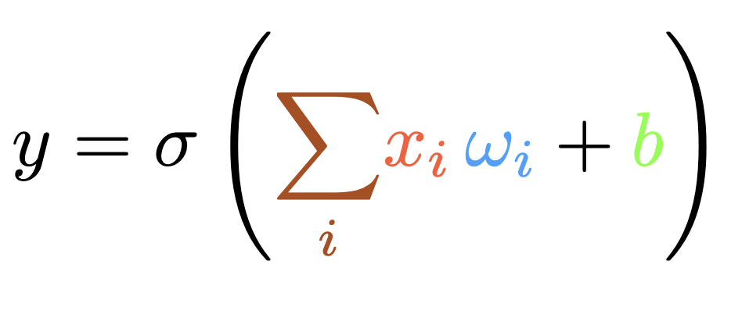


Perceptron
x0
x1
$$\text{Σ}$$
+b
$$σ$$
y
x2
x3

Slide 57
Perceptron
x0
x1
y
Contains a weighted sum of the input nodes, possible addition by a bias term, and then evaluation with an activation funciton
x2
x3

Slide 58

Perceptron
x0
b
x1
$$\text{Σ}$$
$$σ$$
y
x2
x3

Slide 59
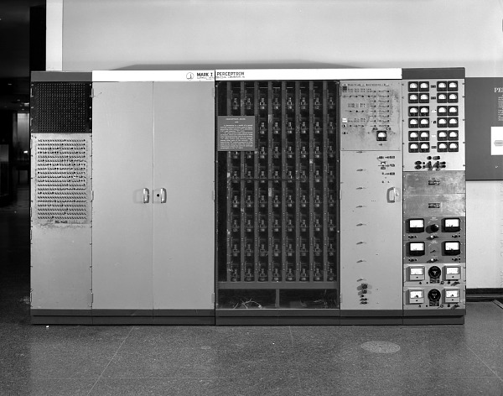
Perceptron

Slide 60
Practical #3: PyTorch for ML
Follow the tutorial on building a simple regressor in PyTorch
Extend this to either a multi linear regressor, or a classifier
Feel free to use the Iris dataset if you prefer!

Slide 61
Classification
Take the regression practice and throw a softmax on the end
So far we have dealt with linear models, which cannot model most real world cases
One of the magic ingredients of neural networks are activation functions…

Slide 62
Practical 3
Logistic regression

Slide 63
Practical 3 Code + Answers

Slide 64
Summary so far – should have taken 2 hours up to this point
We have looked at two different ML problems: regression and classification
We have used non-deep techniques, amenable because our datasets were small and low-dimensional
We defined feed-forward models to make predictions
We used appropriate loss functions to evaluate the model’s performance
We used PyTorch’s automatic tools for computing the gradient and updating the learning paramters
A linear layer plus a sigmoid function gave a non-linear response

Slide 65
Why shallow networks are limited
Single-layer networks require a lot of parameters
Inefficient to search universal space for optimal mapping

Slide 66
Deep learning
Deep learning aims to essentially define more complex functions
But you need lots of data
Or smart way to constrain the search space: inductive bias
Deep networks are much better at approximating complex functions
Assumption is that effective ML reasoning goes through layers of abstraction

Slide 67
Neural Networks
We have all the building blocks. Neural networks aren’t more complicated, they’re just deeper…

Slide 68
Neural Networks
Focusing in on the perceptron model. Neural networks expand this to have multiple inputs and multiple outputs. We call this a layer. Then stack multiple layers in series. This stacking defines a multi-layer perceptron i.e. a deep neural network.

Slide 69
Activation Functions
Maybe leave this for Maximillian?
Compare ReLU, arctanh, sigmoid

Slide 70
PyTorch implementation

Slide 71
Backpropagation
Is one part of the optimizer (but not all of it)
An efficient application of the chain rule, relying on dynamic programming

Slide 73
Show the benefits…

Slide 74
Universal Approximation Theorem
Universal Approximation Theorem

Slide 75
More about backpropagation
I should probably cover this
We have a composition of functions, thus we can apply the chain rule
The efficient computation of the gradients is what is highly optimized in modern ML packages

Slide 76
More about optimisers?
This can maybe be left for Maximillian

Slide 77
Example
Penguin classification with PyTorch NN

Slide 78
Things I haven’t said
How does backpropagation work?
What other choices do I have for loss functions?
How do optimizers work and which is best?
What if my data has some inherent structure I can utilize?
Optimizing hyperparameters
Reducing overfitting

Slide 79
Challenges (45 minutes)
House price regression
LHC data events binary classification

Slide 80
Mini Challenge #1
Build a simple NN classifier to distinguish between H → 4l and the ZZ → 4l channel
If you don’t care about particle physics, treat this as a generic classification problem
Tasks:
Load data
Split into training/validation/testing sets
Build a NN
Build a training function
Train
Visualise output

Slide 81
Mini Challenge #2
House price regression

Slide 82
Particle Physics in a slide
Underneath Geneva, we collide protons in the Large Hadron Collider, and record the collision data using dedicated experimental detectors.
This gives us enormous, highly structured data sets which are a rich playing field for machine learning.
Example: the observation of the Higgs boson was made in 2012, in part through the process of Higgs bosons decaying to 4 leptons which were then recorded in the ATLAS and CMS detectors. We can mimic part of this analysis by training a NN classifier to

Slide 83
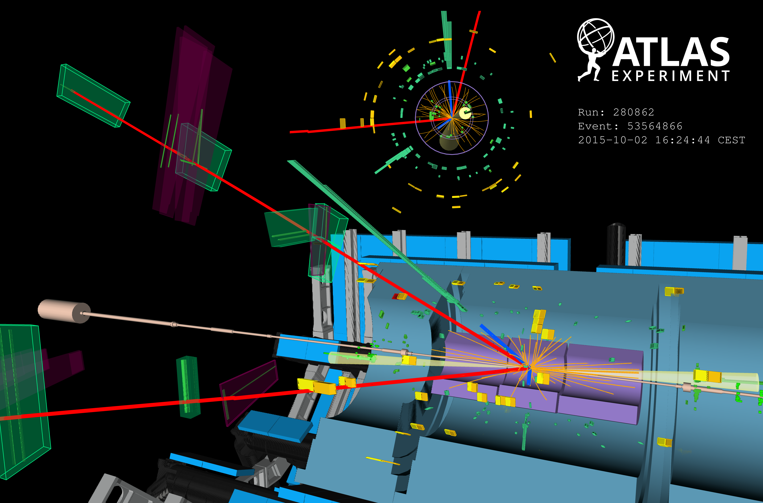

Slide 84
Beyond depth
Introduce more inductive bias

Slide 85
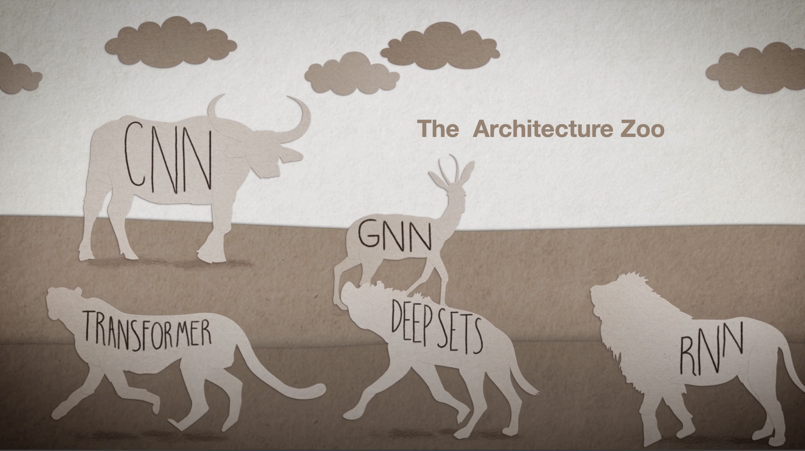
Beyond depth

